Slide 1
Lifeboats on the OCS – Perspectives from MODU and Production Operators
Tom Horan, Manager Marine Compliance and Regulatory Affairs – Rowan Companies, Inc.
Chris Woodle, Marine Regulatory Advisor – Chevron Gulf of Mexico Business Unit

Slide 2
Introduction
Issues and accidents with lifeboats continue to occur in the Maritime industry with regular frequency (even as recently as 6 Feb - Chemtrans Nova), often times resulting in crew fatalities
Lifeboat applications on OCS units are not much different
In certain applications this risk is magnified due to a variety of issues having to do with regulatory requirements, training, choice of appliance, and operations
Risk / Consequence

Slide 3
Perspectives from a MODU Operator - Issues
The main issue our industry has come across has to do with gaps in design and/or maintenance, lack of recognition at the Human Machine Interface (HMI) and/or simply Human Error.
The majority of lifeboat accidents happen during recovery of the boat or during routine maintenance subsequently resulting in a general level of fear to the crews.
Typical number of lifeboats on a ship is 1-2. On a MODU 4-6 due to the number of max POB
Over 2000 LBs on currently market contracted rigs, would be over 3000 if all were working
More boats require more maintenance and more certified coxswains (e.g. Norway – 48 total per rig with 4 x 54/60 PAX boats based on 6 crew rotation)

Slide 4
Perspectives from a MODU Operator - Issues
Not all drills are the same
Rescue boats
Fully loaded or operational crew
Launching Appliance (Cranes)
Lifeboat systems are designed for evacuation and not necessarily for drills
Not all designs are the same (twin fall / single fall, on load / off load releases (hooks), davits, winches, country of manufacture, etc.)
Continued use for the purpose of drills results in wear and tear on winches, brakes, falls, connections, etc.
An accidental release could result in a potential fall from 100ft or more depending on mode of operation (Risk / Consequence – see example)
US regulatory requirements (Sub N) trail behind International requirements (MODU Code(s)/SOLAS)
IMO allows for alternative methods for MOUs (MSC Circ 1486)

Slide 5
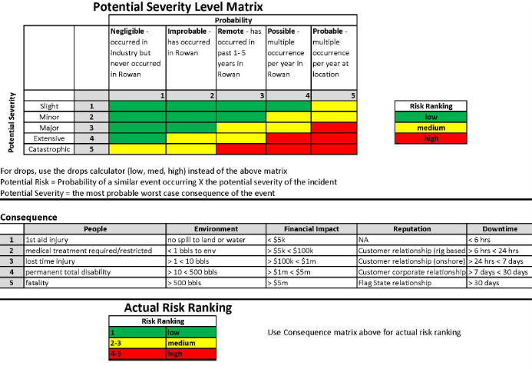
Risk / Consequence

Slide 6
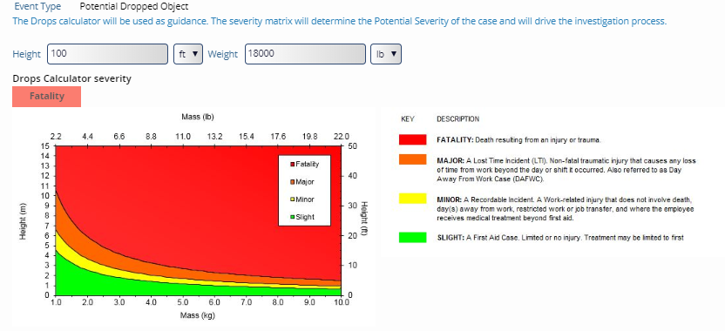
Risk / Consequence

Slide 7
Perspectives from a Production Operator - Overview
Regulatory
Dated regulatory framework
Regulations never developed specific to platforms
Equipment selection (single-fall vs dual-fall boats)
Operational challenges
Training
Equipment selection
Launch/recovery from a platform (air gap, eddies, not fit-for-purpose equipment, etc.)

Slide 8
Perspectives from a Production Operator -Regulatory
Dated and incomplete regulatory construct
No regulations developed specifically for production…borrows from MODU regs (ships)
No risk-assessment has ever been done in the GOM
Wide disparity between what is required on fixed vs floating platforms irrespective of water depth, distance from shore, POB limits, etc.
Requirements for full launch (annually vs quarterly)

Slide 9
Perspectives from a Production Operator –Regulatory (cont.)
Requirements for training/competency
Policy for floaters
Nothing for fixed platforms
Loading in the stowed position to satisfy time requirements
Excessive equipment requirements
Need less ambiguous marine casualty regulation to capture issues
Equipment design/testing standards
Excessive brake testing during 10% overload test
Fall length
20° adverse list not always practical

Slide 10
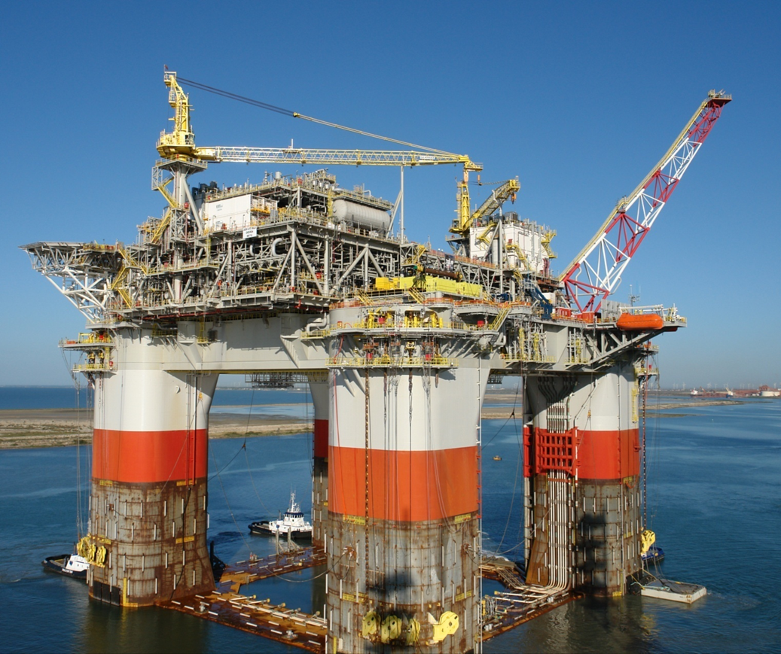
192’ to the water in this picture…
~93’ at operational draft…

Slide 11
Perspectives from a Production Operator – Equipment Selection
Single-fall vs Dual-fall boats
Single-fall are better suited for platforms in terms of ability to recover the boat after full launch tests
Single-fall better suited to be dual-rated as rescue boats (eliminates need for separate FRC)
Single-fall have much less complex launching systems
Dual-fall available in much larger capacity (more POB = fewer boats)
Somewhat more selection in the dual-fall models

Slide 12
Perspectives from a Production Operator – Operational Challenges
Launching is the easy part…
Damage to boats and high potential for injury to personnel due to swinging D-rings
More difficult to stabilize for reconnection to falls (eddies, static platform, increased air gap, no hull to help guide, etc.)
Increased shock loading of hooks during reconnection
Training and operator competency varies

Slide 13
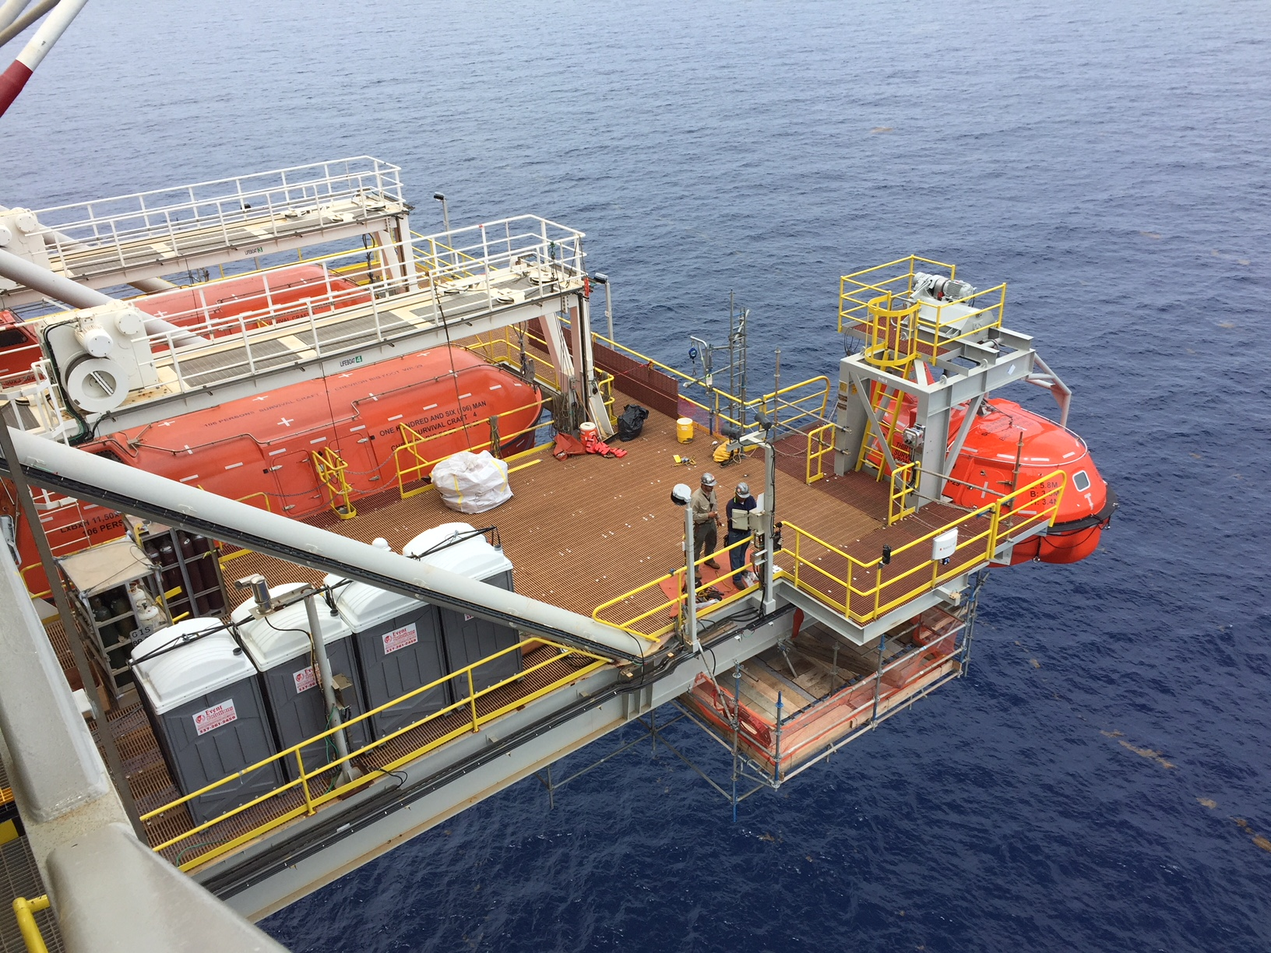

Slide 14
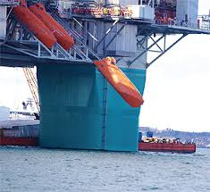

Slide 15
Recommendations
CG should consider issuing a comprehensive Task Statement to NOSAC that addresses the specific challenges OCS units face with regard to lifeboats and other survival equipment.
CG should develop policy/best practices for platforms “under construction” (vice operational). Sail-out (Quarters Habitable), Hook-up and Commissioning (HUC), etc.
CG should develop policy on a “GOM Standard” equipment list for lifeboats on production platforms (fixed and floating)
CG inspectors should attend Lifeboatman training to better understand equipment risks and perspectives from operators.
CG policy should not compel unsafe practices (i.e. full loading of boats in the stowed position)
Alternative training methods and equipment design should be pursued

